Slide 1

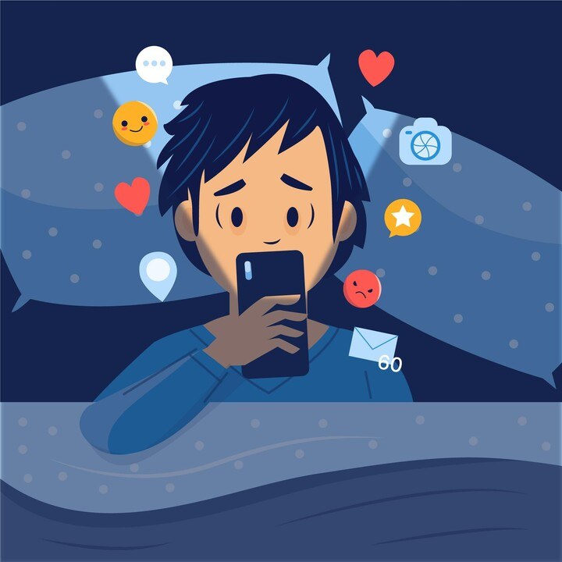

Presentation 2023
Exploring the Relationship between Social Media Behaviour and Mental Health Status
Group 24-25J-106

Slide 2
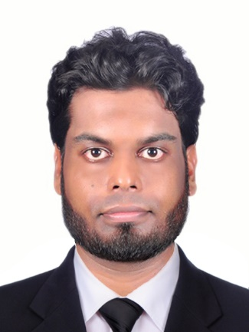


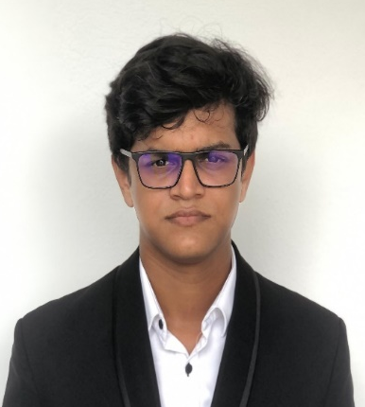
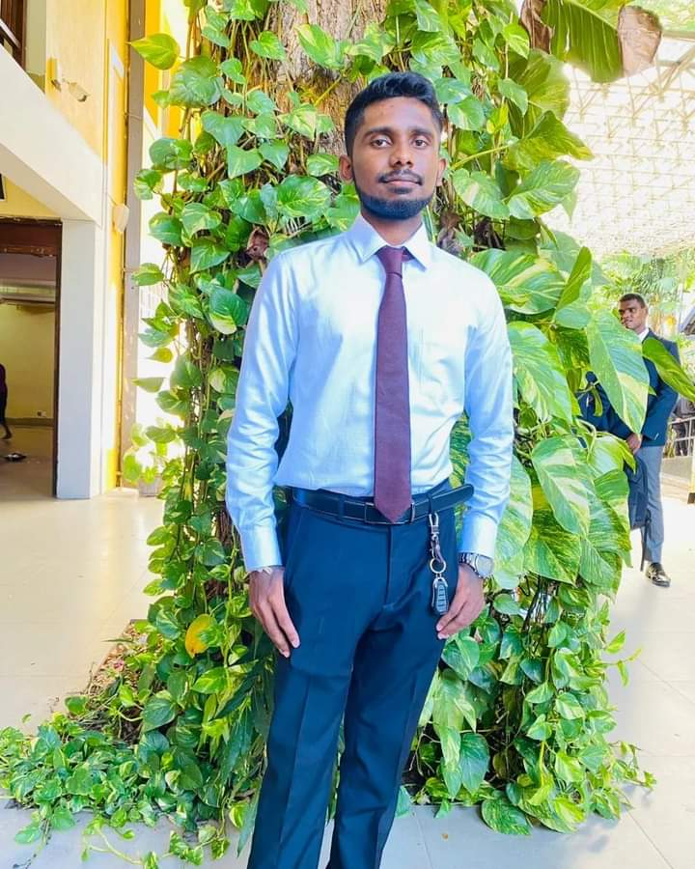
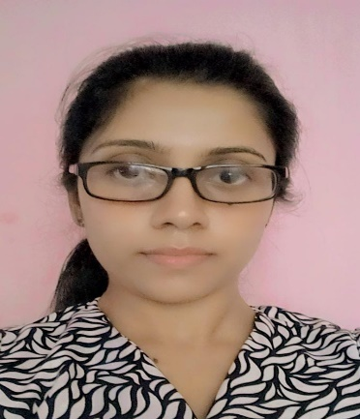
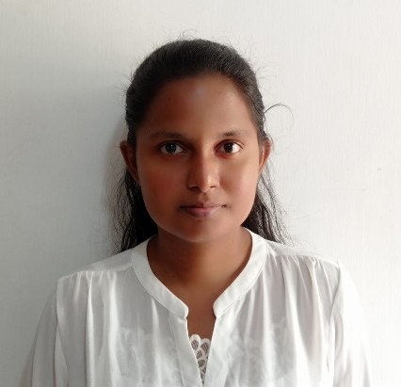

Our Team…
Supervisor
Dr. Junius Anjana
Co-Supervisor
Dr. Bhagya Nathali Silva
External Supervisor
Soorya Jayarathne
(Psychological Conselor)
Senadheera W.D.N.D.
Amarasinghe R.A.D.T.
Ekanayaka E.M.C.S.
Nanayakkara A.A.R.

Slide 3

Content
01 Introduction
02 Research Question
03 Objectives
04 Overall System Diagram
05 Individual Components
06 Commercialization Plan
07 Budget
08 Appendix

Slide 4



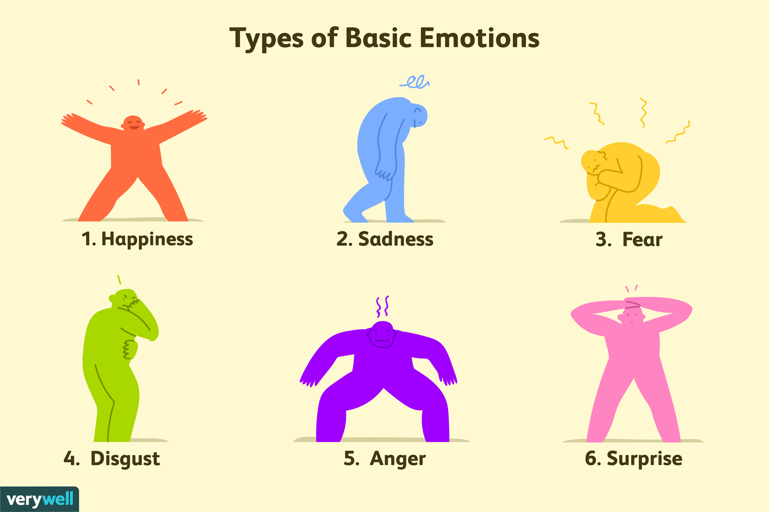
Introduction to the overall project
Most people hide their real feelings from the society.
But now a day’s people frequently use social media.
It can be identified through their social media behavioral patterns.
Social media behaviors act like a mirror of people, it reflects human psychology status.

Slide 5

Introduction cont.
This research is focusing on the discovering the mental health status using social media behavioral patterns and highlighting the connectivity patterns of psychological status with social media behavioral patterns.

Slide 6



Research Question
How can user behaviors on social media be analyzed to uncover their true mental health status, particularly among youth who may be masking their real emotions behind a digital facade?

Slide 7
Objectives
Main Objective
Creating a mobile application to identify the mental health status from the social media behavioral patterns for young people from age 18 to 30.
Identify the short-term mental status
Identify the long-term mental status
Sub Objectives
Track the accurate time and durations that user spends on social media platform
Analyze user data and develop a data model to predict mental status

Slide 8
Overall System Diagram
Facial Expression Basis Analysis
Analyze and final conclution
Our System
(Health Hub)
Social Media Platforms
Divided the 24hrs into 3 segments
Scroll Detection
Capture the face
Analyze the facial expression using cutom CNN model
Predict the user's mental status of previous time segment.
Content Basis Analysis
Scroll Detection
Capture the content on the screen
Analyze the content expression using cutom NLP model
Predict the user's stress level of previous time segment
Time Stamp Analysis
Make a prediction of user's mental status for current time slot
Rcord login and logout times
Analyze the session duration
Track the time of the day

Slide 9
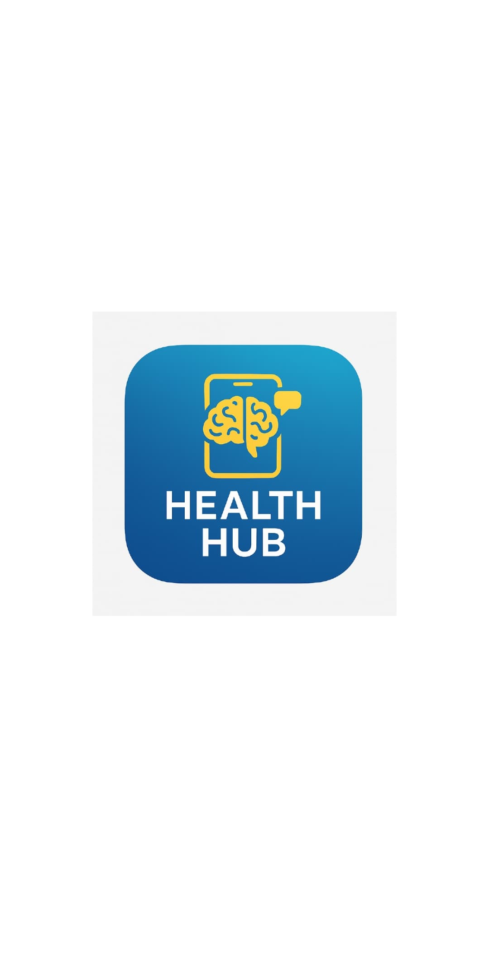
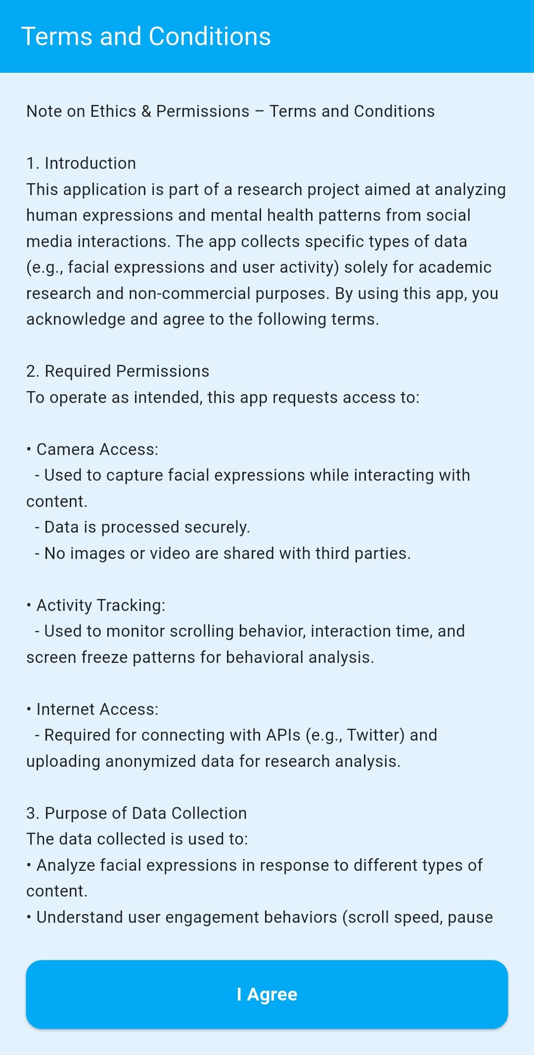
System UI

Slide 10
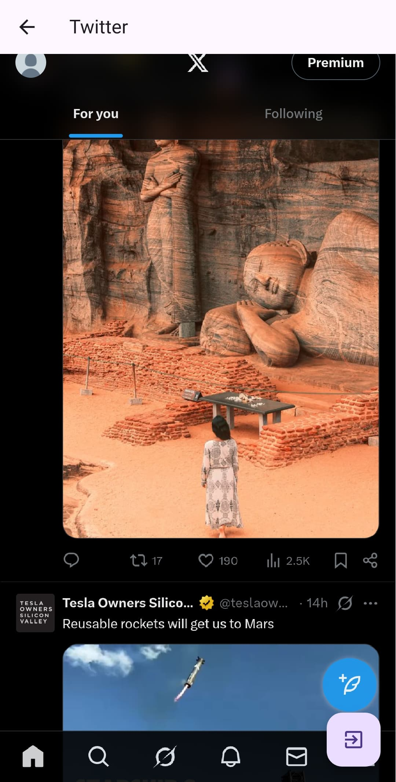
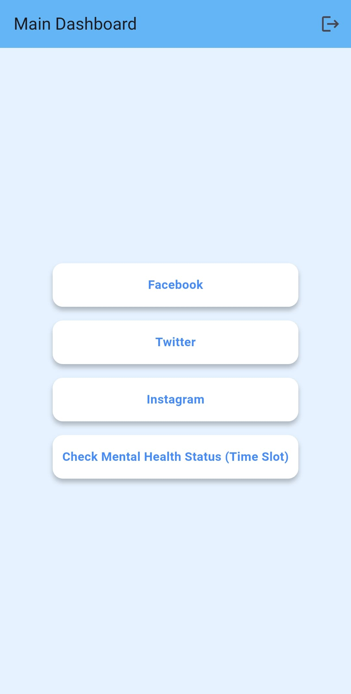
System UI

Slide 11
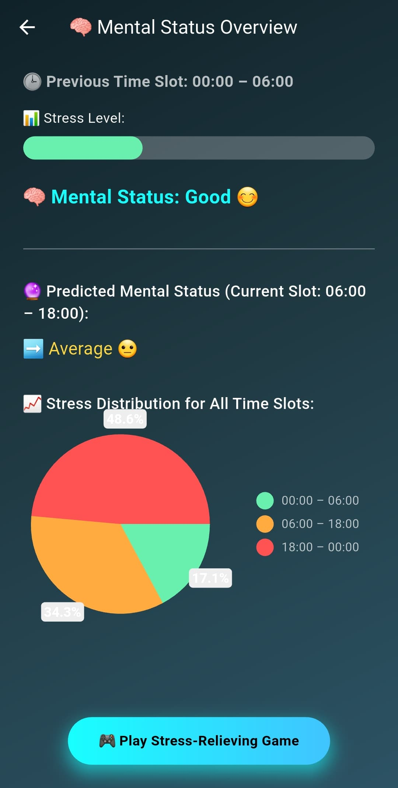
System UI

Slide 12

Individual Components

Slide 13
Identify the short-term mental status IT21292118 - Amarasinghe R.A.D.T. Information Technology
IT21292118 | Amarasinghe R.A.D.T. | 24-25J-106

Slide 14
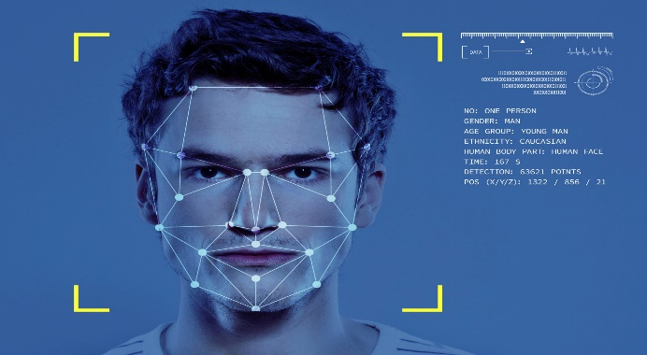
Introduction
This proposed research component analyzes the human expression while the user reads posts.
Identify the face by tracking the user’s scroll behaviors and capture the image of the face.
Analyze the expression by doing image processing on the recognized face.
IT21292118 | Amarasinghe R.A.D.T. | 24-25J-106

Slide 15
Research Gap
Features | Research [1] | Research [2] | Research [3] | Research [4] | Propose system
Identify the user behavior. | ❌ | ✅ | ❌ | ✅ | ✅
Time on post measurement. | ❌ | ❌ | ❌ | ❌ | ✅
Content basis face recognition. | ❌ | ❌ | ❌ | ❌ | ✅
Facial expression analysis. | ❌ | ❌ | ❌ | ❌ | ✅
Categorize the specific expression. | ❌ | ❌ | ❌ | ✅ | ✅
Identify the expression type. | ❌ | ❌ | ❌ | ❌ | ✅
IT21292118 | Amarasinghe R.A.D.T. | 24-25J-106

Slide 16
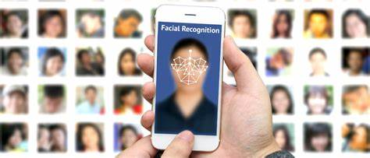
Research Question
How can identify the emotions and emotional response patterns by analyzing the detected facial expressions while reading social media contents and what is the correlation between the content type and the user’s facial expression?
IT21292118 | Amarasinghe R.A.D.T. | 24-25J-106

Slide 17
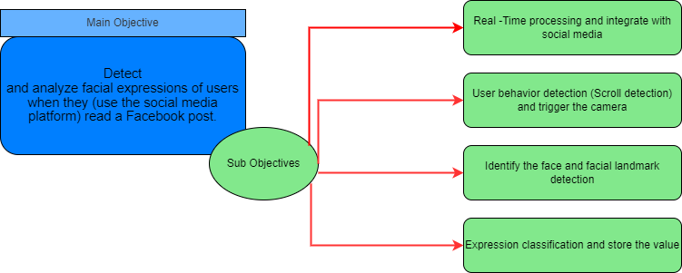
Objectives
IT21292118 | Amarasinghe R.A.D.T. | 24-25J-106

Slide 18
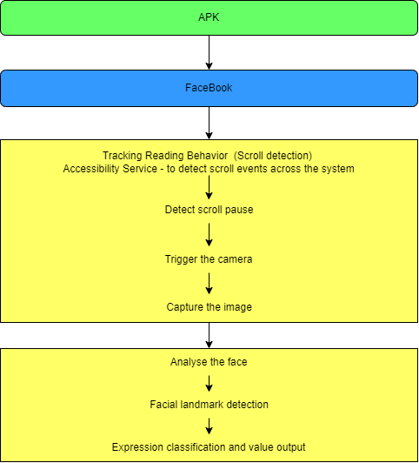
Methodology
Our System
Social Media Platforms
IT21292118 | Amarasinghe R.A.D.T. | 24-25J-106

Slide 19







Technologies, Techniques and Algorithms
Technologies
Visual Studio
Flutter
Python
TensorFLow
GitHub
Sql lite
Techniques
HOG , SVM – Detection
Dlib – Landmarks
CNN – Emotion Recognition
LDA – Feture Extraction
Algorithms
Data Argumentation
Segmentation
Pattern Recognition
IT21292118 | Amarasinghe R.A.D.T. | 24-25J-106

Slide 20
Requirements
Functional Requirements
Data Integration
Predictive Model
Data Security
Pattern Recognition
Data Security
Non-Functional Requirements
Accuracy
Scalability
Reliability
Privacy and Security
Usability
Quick Response Time
Data Integrity
Software Requirements
Visual Studio
Python
Pandas
Computer Vision
IT21292118 | Amarasinghe R.A.D.T. | 24-25J-106

Slide 21
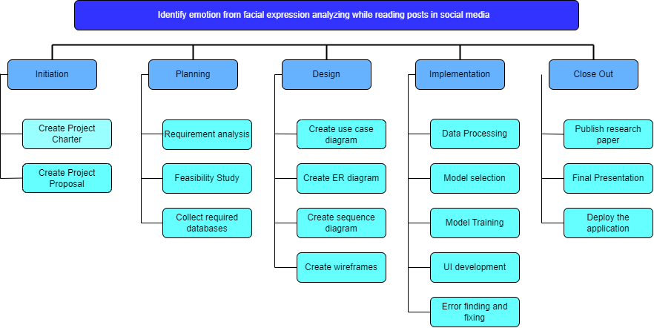
Work breakdown structure (WBS)
IT21292118 | Amarasinghe R.A.D.T. | 24-25J-106

Slide 22
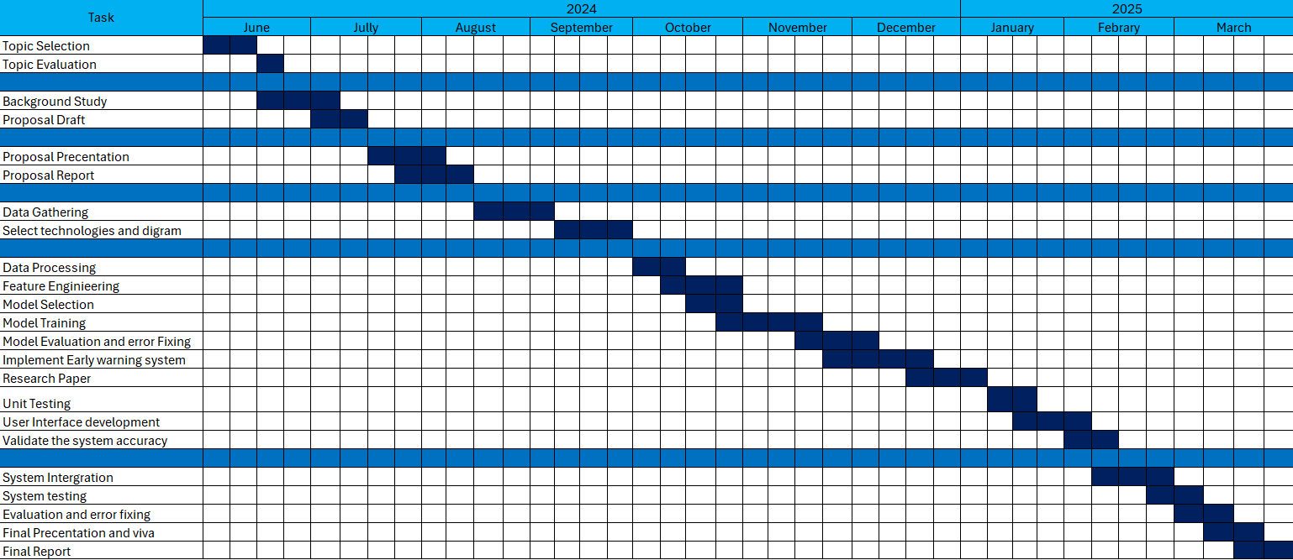
Gantt Chart
IT21292118 | Amarasinghe R.A.D.T. | 24-25J-106

Slide 23
References
[1] Hunt J, Eisenberg D. Mental health problems and help-seeking behavior among college students. J Adolesc Health. 2010;46(1):3–10. [PubMed] [Google Scholar]
[2] Megan A. Moreno M.D. Feeling bad on Facebook: depression disclosure by college student on a social network site. 11 March 2011 https://doi.org/10.1002/da.20805
[3] Kross, E., et al. (2013). Facebook Use Predicts Declines in Subjective Well-Being in Young Adults. PLOS ONE.
[4] Guntuku, S. C., et al. (2019). Detecting Depression and Mental Illness on Social Media: An Integrative Review. Current Opinion in Behavioral Sciences.
[5] C Marino, G Gini, A Vieno, MM Spada - Journal of affective disorders, 2018 – Elsevier https://doi.org/10.1016/j.jad.2017.10.007
[6]JA Naslund, KA-Aschbrenner, LA Marsch health 2016 - https://doi.org/10.1177/2055207616654822
[7] Potential of social media in promoting mental health in adolescents. O'Reilly M, Dogra N, Hughes J, Reilly P, George R, Whiteman N. https://www.ncbi.nlm.nih.gov/pubmed/30060043 Health Promot Int. 2018;34:981–991.
IT21292118 | Amarasinghe R.A.D.T. | 24-25J-106

Slide 24

Identify the long-term mental status IT21371790 - Ekanayaka e.m.c.s. Information Technology
IT21371790 | Ekanayaka E.M.C.S. | 24-25J-106

Slide 25

Introduction
Identify long-term (within 24 hours) mental status by analyzing social media behavioral patterns from user shared or created posts. Then analyze sentiment and calculate as percentage. Hope to use Machine learning, NLP, DMBS and data visualization.
IT21371790 | Ekanayaka E.M.C.S. | 24-25J-106

Slide 26
Research Gap
 | Research [1] | Research [2] | Research [3] | Propose system
Dynamic long-term tracking | ❌ | ❌ | ❎ | ✅
sentiment analysis (using NLP) | ❌ | ❌ | ✅ | ✅
Comprehensive data tracking | ✅ | ❌ | ❌ | ✅
Database driven insights | ✅ | ✅ | ✅ | ✅
IT21371790 | Ekanayaka E.M.C.S. | 24-25J-106

Slide 27
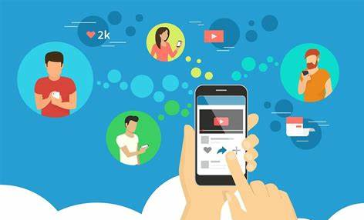
Research Question
How can long-term (within 24 hrs.) mental health status be accurately identified through the analysis of social media behavioral patterns and sentiment trends using Natural Language Processing (NLP)?
IT21371790 | Ekanayaka E.M.C.S. | 24-25J-106

Slide 28
Objectives
Main Objectives
Track and analyze social media posts over a 24-hour period to identify the mental health status of users from using NLP.
Sub objectives
To track user-generated social media posts and shares within a 24-hour period
To apply NLP techniques to analyze the sentiment of the content
To calculate and quantify the percentage of positive and negative sentiment
To store the sentiment analysis results in a structured database
IT21371790 | Ekanayaka E.M.C.S. | 24-25J-106

Slide 29
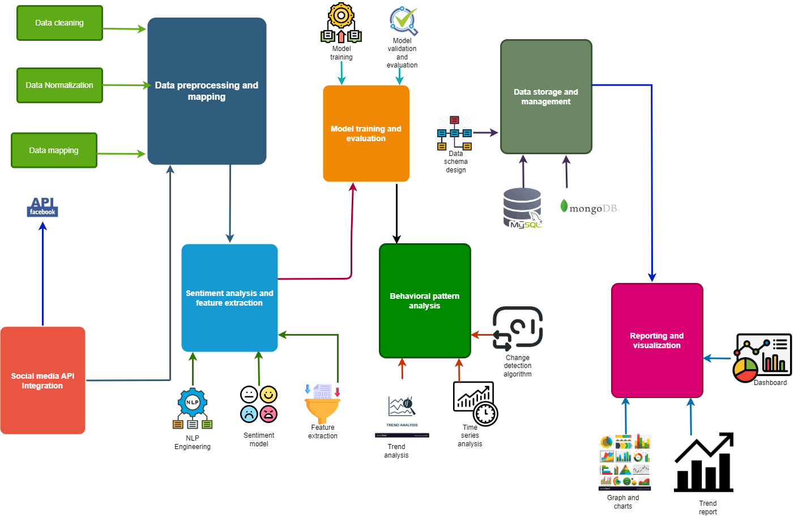
Methodology
IT21371790 | Ekanayaka E.M.C.S. | 24-25J-106

Slide 30
Technologies, Techniques and Algorithms
Technologies
Flutter
Python
My SQL
NLP
Github
TensorFlow
PyTorch
Techniques
Deep Learning-Based Sentiment Analysis
Trend Analysis
Sequential Pattern Mining
Algorithms
Naive Bayes Classifier
Support Vector Machine
Time Series Analysis
Decision Trees
IT21371790 | Ekanayaka E.M.C.S. | 24-25J-106

Slide 31
Requirements
Functional Requirements
Data Collection
Sentiment Analysis
Sentiment Calculation
Data Storage
Non-Functional Requirements
Performance
Scalability
Reliability
Security
Usability
Maintainability
Data Integrity
Software Requirements
Python
Pandas
Android Studio
IT21371790 | Ekanayaka E.M.C.S. | 24-25J-106

Slide 32
Work breakdown structure (WBS)
Identify long term mental (24 hrs) status
Data Collection
Sentiment Analysis
Monitoring and Analysis
Reporting
Select Social Media Platforms and APIs
Implement NLP Tools for Sentiment Analysis
Track Sentiment Changes Over 24-Hour
Generate Reports on Long-Term Mental Status
Calculate Positivity/Negativity Percentage
Extract User Posts and Feeds
Analyze Patterns in Mental Status
Visualize Sentiment Trends and Patterns
Identify Regular Periods of Status Change
Preprocess and Clean the Data
Store Sentiment Data in Database
IT21371790 | Ekanayaka E.M.C.S. | 24-25J-106

Slide 33
Gantt Chart
IT21371790 | Ekanayaka E.M.C.S. | 24-25J-106

Slide 34
References
[1] Hunt J, Eisenberg D. Mental health problems and help-seeking behavior among college students. J Adolesc Health. 2010;46(1):3–10. [PubMed] [Google Scholar]
[2] Megan A. Moreno M.D. Feeling bad on Facebook: depression disclosure by college student on a social network site. 11 March 2011 https://doi.org/10.1002/da.20805
[3] Ethan Kross, Philippe Verduyn, Emre Demirel,Jiyoung Park, David Seung Jae Lee, Natalie Lin, Holly August 14, 2013 https://doi.org/10.1371/journal.pone.0069841
[4] L Braghieri, R Levy, A Makarin American Economic Review 112 (11), 3660-93 https://assets.aeaweb.org/asset-server/files/17593.pdf
[5] C Marino, G Gini, A Vieno, MM Spada - Journal of affective disorders, 2018 – Elsevier https://doi.org/10.1016/j.jad.2017.10.007
[6]JA Naslund, KA-Aschbrenner, LA Marsch health 2016 - https://doi.org/10.1177/2055207616654822
IT21371790 | Ekanayaka E.M.C.S. | 24-25J-106

Slide 35
Track times and durations that user spends on the platform IT21700156 - Nanayakkara A.A.R. Information Technology
IT21700156 | Nanayakkara A.A.R. | 24-25J-106

Slide 36

Introduction
The main purpose of this function is to accurately get the time spent by the user in the social media platform. It has two main things.
1) Tracked the user login time into social media platform
2) Using face recognition, get the accurate time
IT21700156 | Nanayakkara A.A.R. | 24-25J-106

Slide 37
Research Gap
 | Research [1] | Research [2] | Research [3] | Research [4] | Propose system
Calculation of total time spent on the platform, both in aggregate and per session. | ❌ | ❌ | ❌ | ❌ | ✅
Face Recognition | ❌ | ❌ | ❌ | ❌ | ✅
Differentiating between short, medium, and long sessions. | ❌ | ✅ | ❌ | ❌ | ✅
Analyze the negative or positive mood with using start and end time difference. | ✅ | ❌ | ❌ | ❌ | ✅
IT21700156 | Nanayakkara A.A.R. | 24-25J-106

Slide 38

Research Question
How can user behavior on a social media platform, including time spent, at what time do you use social media and sentiment analysis of user-generated content, be effectively tracked?
IT21700156 | Nanayakkara A.A.R. | 24-25J-106

Slide 39
Objectives
Main Objectives
Track the times and time durations that the user spends on the platform. Then get their timelines and calculate the accurate time that user spend on the platform and store it in a database.
Sub objectives
User Activity Monitoring
Image Processing for Facial Recognition
Sentiment Analysis Implementation
Integration with Database
IT21700156 | Nanayakkara A.A.R. | 24-25J-106

Slide 40
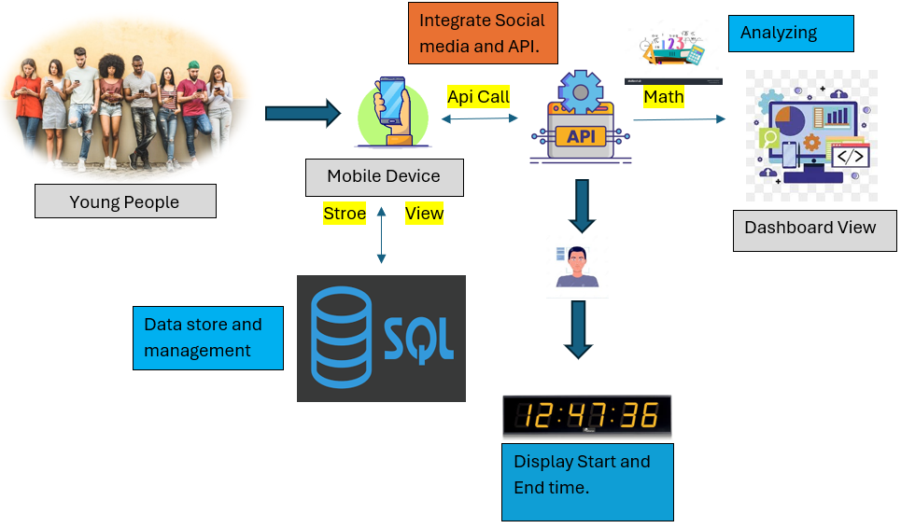
Methodology
IT21700156 | Nanayakkara A.A.R. | 24-25J-106

Slide 41
Technologies, Techniques and Algorithms
Technologies
Flutter
Python
Visual Studio
Github
TensorFlow
PyTorch
Colab
Techniques
Pattern recognition
Data argumentation
User Interface Learning
Computer Vision
Algorithms
Artificial Neural Networks
Decision Trees
IT21700156 | Nanayakkara A.A.R. | 24-25J-106

Slide 42
Requirements
Functional Requirements
Data Integration
Predictive Model
Data Security
Sentiment Analysis
Reporting and Visualization
Data Storage
Non-Functional Requirements
Accuracy
Scalability
Reliability
Privacy and Security
Usability
Quick Response Time
Data Integrity
Software Requirements
Python
Pandas
PyTorch
Android Studio
JWT (JSON Web Tokens)
RESTful or GraphQL
JavaScript libraries
Computer Vision
IT21700156 | Nanayakkara A.A.R. | 24-25J-106

Slide 43
Work breakdown structure (WBS)
Identify and analyze the young adult's mental health status using social media behavioral patterns
Initiation
Planning
Design
Implementation
Close out
Create project charter
Requirement analysis
Create use case diagram
Data processing
Publish research paper
Feature engineering
Create project proposal
Feasibility Study
Create ER diagram
Final presentation
Model selection
Collect required data
Create sequence diagram
Model training
Deploy the web application
Design wireframes for mobile application
Model evaluation
User Interface development
Error fixing
IT21700156 | Nanayakkara A.A.R. | 24-25J-106

Slide 44
Gantt Chart
IT21700156 | Nanayakkara A.A.R. | 24-25J-106

Slide 45
References
[1] Hunt J, Eisenberg D. Mental health problems and help-seeking behavior among college students. J Adolesc Health. 2010;46(1):3–10. [PubMed] [Google Scholar]
[2] Megan A. Moreno M.D. Feeling bad on Facebook: depression disclosure by college student on a social network site. 11 March 2011 https://doi.org/10.1002/da.20805
[3] Kross, E., et al. (2013). Facebook Use Predicts Declines in Subjective Well-Being in Young Adults. PLOS ONE.
[4] Guntuku, S. C., et al. (2019). Detecting Depression and Mental Illness on Social Media: An Integrative Review. Current Opinion in Behavioral Sciences.
[5] C Marino, G Gini, A Vieno, MM Spada - Journal of affective disorders, 2018 – Elsevier https://doi.org/10.1016/j.jad.2017.10.007
[6]JA Naslund, KA-Aschbrenner, LA Marsch health 2016 - https://doi.org/10.1177/2055207616654822
[7] Potential of social media in promoting mental health in adolescents. O'Reilly M, Dogra N, Hughes J, Reilly P, George R, Whiteman N. https://www.ncbi.nlm.nih.gov/pubmed/30060043 Health Promot Int. 2018;34:981–991.
IT21700156 | Nanayakkara A.A.R. | 24-25J-106

Slide 46
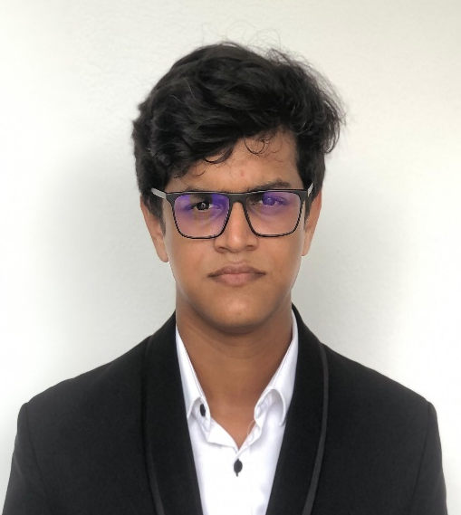
Analyze all databases and BUILD the model IT21220388 - SENADHEERA W.D.N.D. Information Technology
IT21220388 | Senadheera W.D.N.D. | 24-25J-106

Slide 47
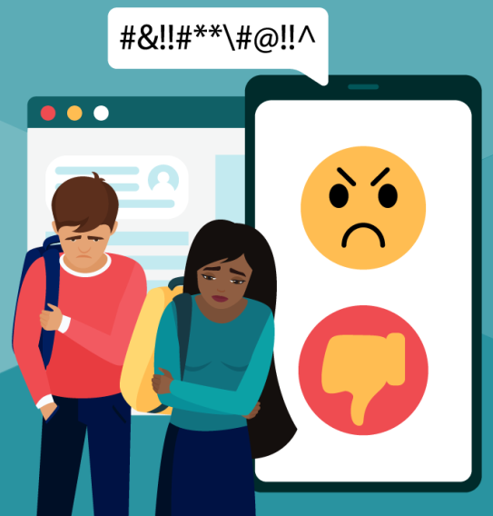
Introduction
In today's digital age, social media is a powerful force shaping the lives of young adults.
The proposed research component mainly based on identifying their mental status.
By analyzing facial expressions, what posts they are sharing and how much time they spend on social media
IT21220388 | Senadheera W.D.N.D. | 24-25J-106

Slide 48
Research Gap
 | Research [1] | Research [2] | Research [3] | Research [4] | Propose system
ANN deep learning algorithms | ❌ | ❌ | ❌ | ❌ | ✅
User friendly interface | ❌ | ❌ | ❌ | ❌ | ✅
Identify average emotion based on data | ❌ | ❌ | ❌ | ❌ | ✅
Users can observe their mental status | ❌ | ❌ | ✅ | ❌ | ✅
Analyzed data showed on real-time or 24hr period | ❌ | ✅ | ✅ | ❌ | ✅
IT21220388 | Senadheera W.D.N.D. | 24-25J-106

Slide 49

Research Question
How can social media behavior, as recorded in various databases, be used to assess the mental health status of users across different age groups?
IT21220388 | Senadheera W.D.N.D. | 24-25J-106

Slide 50
Objectives
Main Objectives
Determine user mental status from analyzing user data and implementing a Data Model.
Sub objectives
Data Model Development
Data Aggregation and Cleaning
Trend and Pattern Identification
Correlation Analysis
IT21220388 | Senadheera W.D.N.D. | 24-25J-106

Slide 51





Methodology
API Call
Values
Young Adults
Users
Mobile Interface
API
Analyzing
Segmentation
Apply Neural Network
Identify Mental Status
Store
View
Database
IT21220388 | Senadheera W.D.N.D. | 24-25J-106

Slide 52

Technologies, Techniques and Algorithms
Technologies
Flutter
Python
Visual Studio
Github
TensorFlow
PyTorch
Colab
Techniques
User Interface Learning
Pattern recognition
Data argumentation
Algorithms
Artificial Neural Networks
Decision Trees
IT21220388 | Senadheera W.D.N.D. | 24-25J-106

Slide 53
Requirements
Functional Requirements
Data Integration
User Interface
Predictive Model
Data Security
Pattern Recognition
Non-Functional Requirements
Accuracy
Scalability
Reliability
Privacy and Security
Usability
Quick Response Time
Data Integrity
Software Requirements
Python.org
Pandas
PyTorch
Computer Vision
Flutter
VS Code
IT21220388 | Senadheera W.D.N.D. | 24-25J-106

Slide 54
Work breakdown structure (WBS)
Identify and analyze the young adult's mental health status using social media behavioral patterns
Initiation
Planning
Design
Implementation
Close out
Create project charter
Requirement analysis
Create use case diagram
Data processing
Publish research paper
Feature engineering
Create project proposal
Feasibility Study
Create ER diagram
Final presentation
Model selection
Collect required data
Create sequence diagram
Model training
Deploy the web application
Design wireframes for mobile application
Model evaluation
User Interface development
Error fixing
IT21220388 | Senadheera W.D.N.D. | 24-25J-106

Slide 55
Gantt Chart
IT21220388 | Senadheera W.D.N.D. | 24-25J-106

Slide 56
References
[1] Hunt J, Eisenberg D. Mental health problems and help-seeking behavior among college students. J Adolesc Health. 2010;46(1):3–10. [PubMed] [Google Scholar]
[2] Megan A. Moreno M.D. Feeling bad on Facebook: depression disclosure by college student on a social network site. 11 March 2011 https://doi.org/10.1002/da.20805
[3] Kross, E., et al. (2013). Facebook Use Predicts Declines in Subjective Well-Being in Young Adults. PLOS ONE.
[4] Guntuku, S. C., et al. (2019). Detecting Depression and Mental Illness on Social Media: An Integrative Review. Current Opinion in Behavioral Sciences.
[5] C Marino, G Gini, A Vieno, MM Spada - Journal of affective disorders, 2018 – Elsevier https://doi.org/10.1016/j.jad.2017.10.007
[6]JA Naslund, KA-Aschbrenner, LA Marsch health 2016 - https://doi.org/10.1177/2055207616654822
[7] Potential of social media in promoting mental health in adolescents. O'Reilly M, Dogra N, Hughes J, Reilly P, George R, Whiteman N. https://www.ncbi.nlm.nih.gov/pubmed/30060043 Health Promot Int. 2018;34:981–991.
IT21220388 | Senadheera W.D.N.D. | 24-25J-106

Slide 57

Future Improvement
Improve model accuracies of text capturing model and image capturing model.
System prediction accuracy need to improve.
Using nighttime data predict if user have depression or anxiety.
IT21220388 | Senadheera W.D.N.D. | 24-25J-106

Slide 58










Commercialization Plan
Psychological Student
Rs.500
Using the proposed application, we hope to provide low-cost subscription plans considering each sides.
Annual Subscription
Rs.1000
Psychological Counselors
Rs.1000
Permanent Subscription
Rs.1500
Social Media Commercialization
Monthly Subscription
Rs.500
For Hospitals
Free Subscription

Slide 59
Budget
Component | Amount (USD) | Amount (LKR)
Travelling fee for the possible consultation sessions (visit external supervisor) | 1.67 | 750.00
Internet charges (Technical information) | 10.00 | 3000.00
Technical consultation charges (External technical information session) | 10.00 | 3000.00
TOTAL | 21.67 | 6750.00

Slide 60

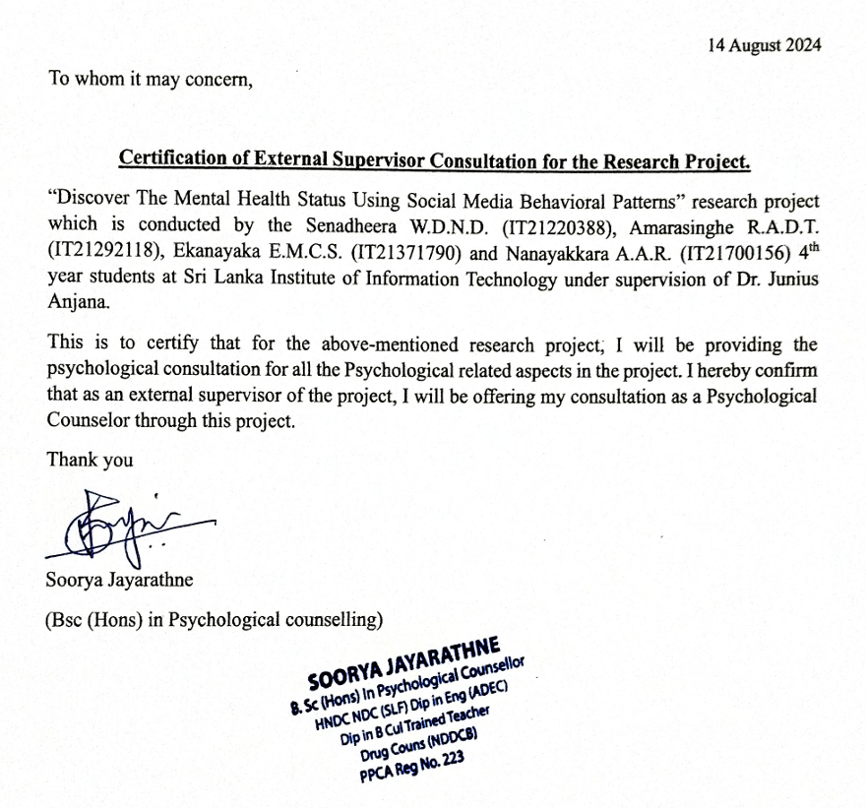
Appendix

Slide 61


Slide 62

THANK YOU!

